Slide 1
IS4432 Systems Design
Week 6 – Database Design
Prepared by Janet Yu
115/11/07

Slide 2
Agenda
Object-persistence formats
Mapping Problem-domain objects to object-persistence formats
Optimizing storage efficiency
Optimizing data access speed
  Denormalization
  Clustering
  Indexing
Non-functional requirements
Data access & manipulation classes
115/11/07

Slide 3
Common Object Persistence Formats
Relational databases (RDBMS)
Object-relational databases (ORDBMS)
Object-oriented databases (OODBMS)
115/11/07

Slide 4
Relational Databases (RDBMS)
Most popular form in the marketplace
Based on collections of tables
Each table has a primary key
Supports foreign keys
Supports referential integrity
Access by SQL
115/11/07

Slide 5
Object-relational Databases (ORDBMS)
Are relational database management systems with extensions to handle the storage of objects in the relational table structure
Through the use of user-defined types
115/11/07

Slide 6
Object-oriented Databases (OODBMS)
Object-relational conversion not required
Use a different language in defining, manipulating and querying objects in an OODBMS
Still used mainly to support multimedia applications or systems with complex data
Why not popular:
  Current investment on ORDBMS by companies
  Mostly RDBMS developers on the market
  Steep learning curve
115/11/07

Slide 7
Mapping Problem Domain Objects to an RDBMS Format (1)
Map all concrete problem-domain classes to the RDBMS tables.
Map single-valued attributes to columns of the RDBMS tables.
Map methods to stored procedures or to program modules.
Map single-valued aggregation and association relationships to a column that can store the key of the related table, i.e. add a foreign key to the table. Do this for both sides of the relationship.
Map multivalued attributes and repeating groups to new tables and created a one-to-many association from the original table to the new ones.
115/11/07

Slide 8
Mapping Problem Domain Objects to an RDBMS Format (2)
Map multivalued aggregation and association relationships to a new associative table that related the two original tables together.
Addresses 1 to N and N to 1 relationships. The multivalued side (0..* or 1..*) should be mapped to a column in its table that can store a foreign key back to the single valued side.
115/11/07

Slide 9
Mapping Problem Domain Objects to an RDBMS Format (3)
Deals with the lack of support for generalization and inheritance. 2 approaches:
  Add a column to each table that represents a subclass for each of the concrete superclasses of the subclass.
  Flatten the inheritance hierarchy by copying the superclass attributes down to all of the subclasses and remove the superclass from the design.
115/11/07

Slide 10
Optimizing Storage Efficiency
Have no redundant data
Very few null values
Use a process called normalization
115/11/07

Slide 11
Normalization
First normal form (1NF)
  No multivalued fields
Second normal form (2NF)
  Data model leads to tables containing fields that depend on a whole primary key
Third normal form (3NF)
  None of the fields depend on nonprimary key fields, i.e. no transitive dependency
115/11/07

Slide 12
Optimizing Data Access Speed
Can use the following techniques to speed up access
  Denormalization
  Clustering
  Indexing
115/11/07

Slide 13
Denormalization
Add redundancy back into the design
Can reduce the number of joins that need to be performed in a query
Should be applied sparingly. Can be used in:
  Situations in which information is queried frequently, yet updated rarely such as look-up tables
  One-to-one relationships
  Cases where it is more efficient to include a parent entity’s attributes in its child entity
115/11/07

Slide 14
Clustering
One way to improve access speed is to reduce the number of times that the storage medium needs to be accessed during a transaction.
By clustering records together physically
  Intrafile clustering
    Like records in one table are stored together in some way
  Interfile clustering
    Combines records from more than one table that typically are retrieved together
115/11/07

Slide 15
Indexing
Like the index located in the back of a textbook
Can perform even faster by placing them into the main memory of the data storage hardware
Guidelines for using
  Use on larger tables
  Use sparingly for transaction systems; use more indexes in decision support systems (non-volatile databases)
  Create index on primary key and on foreign keys used in joins
  Create index for fields that are used frequently for grouping, sorting, or criteria
  When there are >100 values but not when there are <30 values
  Avoid use of indexes for fields with long values; perhaps compress values first
115/11/07

Slide 16
Other Considerations
Performance requirements
  Distributing objects over a network?
  Storing multiple copies?
  Limiting the availability of different objects based on the time of day?
Security requirements
  Access control
  Encryption
  Backup requirements: full, incremental
Cultural requirements
  E.g. date format, length for a name
115/11/07

Slide 17
Data Access & Manipulation Classes
They act as a translator between the object-persistence and the problem domain objects.
A simple rule is one data access and manipulation (DAM) class for each concrete problem domain class
115/11/07

Slide 18
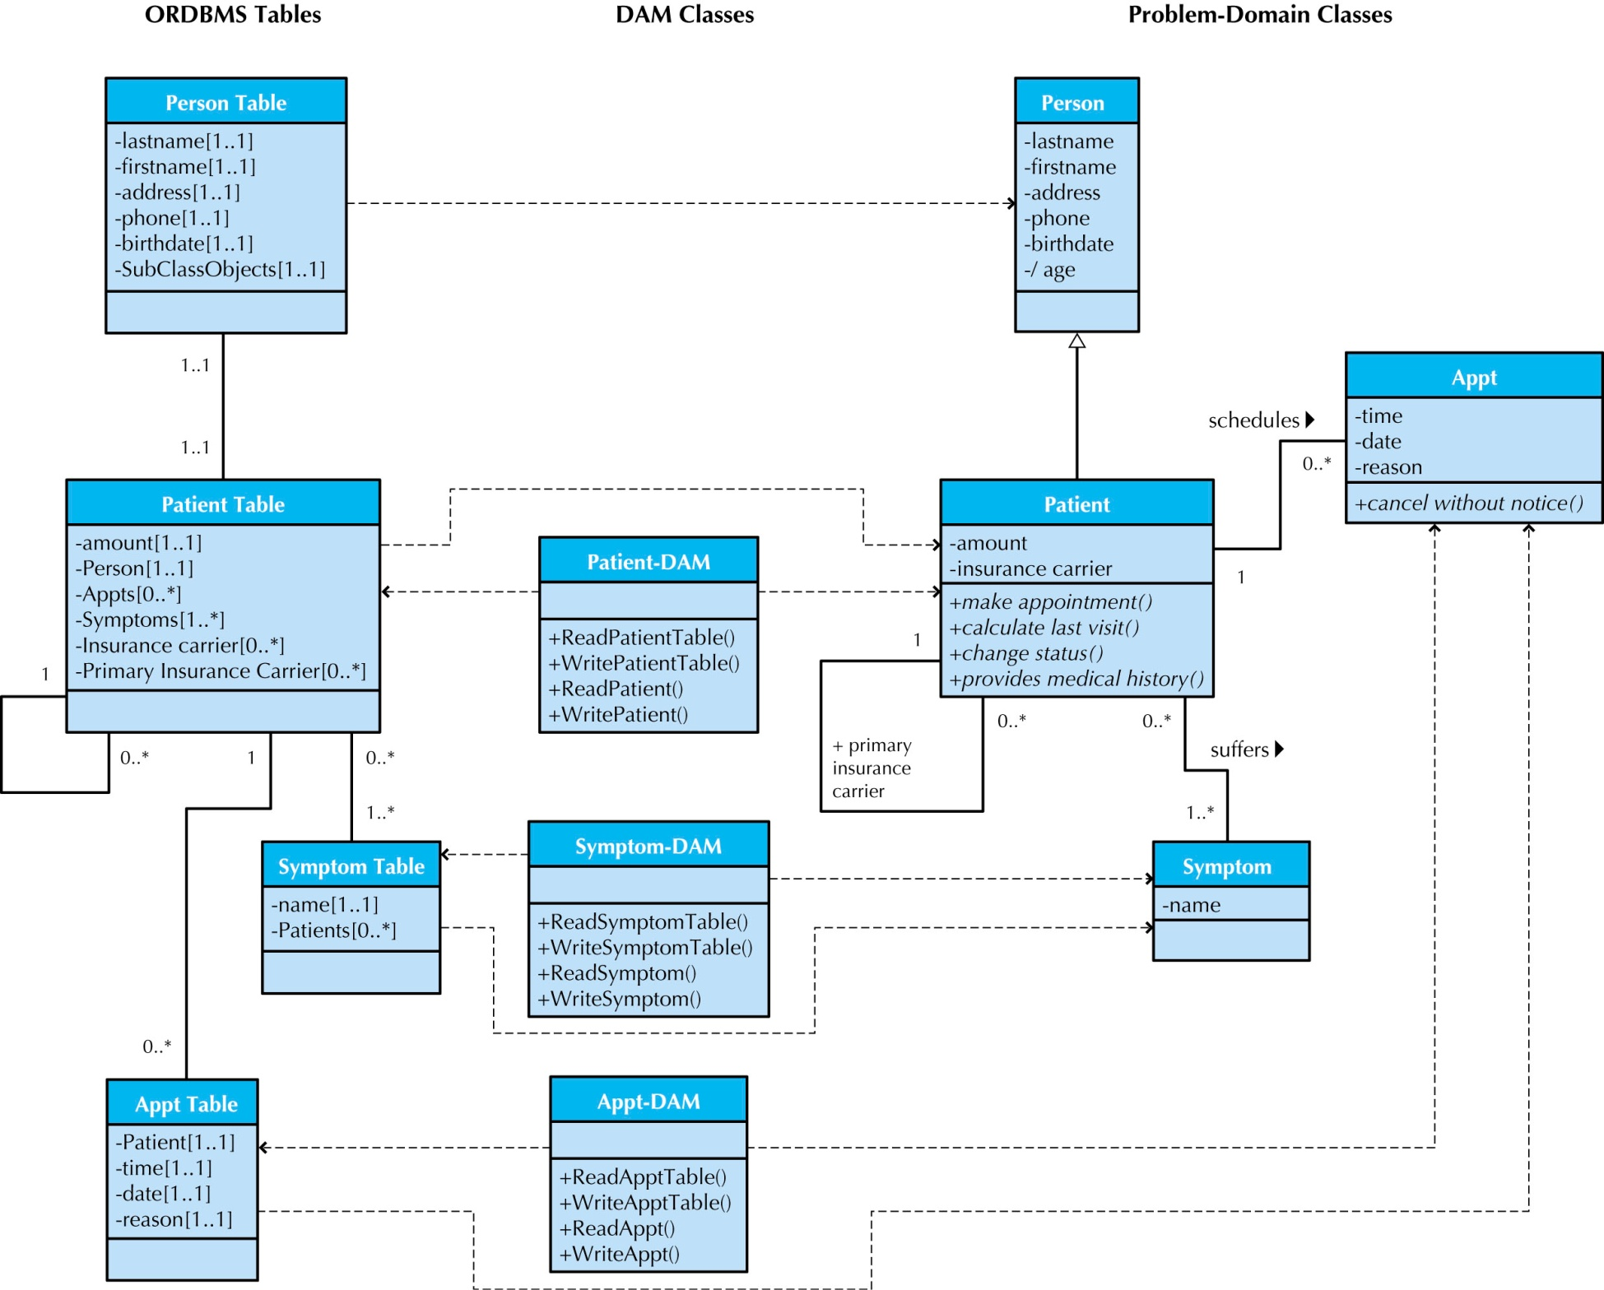
115/11/07

